Slide 1
🚨 Fraud Detection and Analysis using SQL & Power Bi
Vannamathi B
Aspiring Data analyst
Tools : SQL | power bi | Data cleaning

Slide 2
ABOUT ME
🎓 B.Tech – Information Technology
🛠 Skills: SQL, Python, Power BI, Data Cleaning, EDA
💡 Passionate about data-driven decision making
📈 Interested in Fraud Detection, Business Analytics

Slide 3
AGENDA
About Me
Problem Statement
Dataset Overview
Null Handling in SQL
Queries & Analysis
Power BI Visualizations
Insights & Findings
Conclusion & Future Scope

Slide 4
PROBLEM STATEMENT
Fraud is a major challenge in financial transactions.
Raw datasets often contain:
⚠️ Null values (e.g., missing emails, fraud types, detection dates).
⚠️ Large volume of transactions without fraud labels.
Objective:
Clean and preprocess data.
Write SQL queries (Basic → Advanced).
Visualize results in Power BI for fraud insights.

Slide 5
DATASET OVERVIEW
Tables Used:
Customers (CustomerID, Name, Email, Phone, Country, AccountCreationDate)
Transactions (TransactionID, CustomerID, Amount, Date, Merchant, Type, Status)
FraudFlags (TransactionID, IsFraud, FraudType, DetectionDate)
📊 Rows: ~300–400 | Columns: ~15

Slide 6
NULL HANDLING
Customers: Missing Emails filled with "unknown"
FraudFlags: Missing FraudType replaced with "Unknown"
FraudFlags: Missing DetectionDate imputed with "TransactionDate"

Slide 7
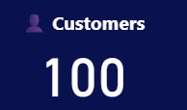
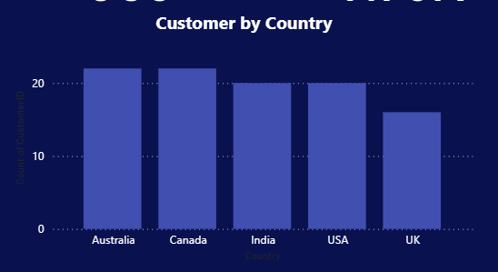
SQL Queries + Power Bi Charts
Total Number of Customer
QUERY:
SELECT COUNT(*) AS TotalCustomers FROM Customers;
Customers by country
QUERY:
SELECT Country,
COUNT(*) AS CustomerCount FROM customers GROUP BY Country;

Slide 8
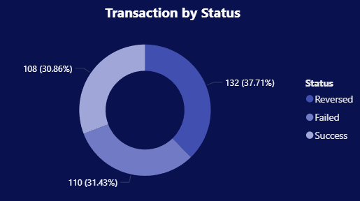
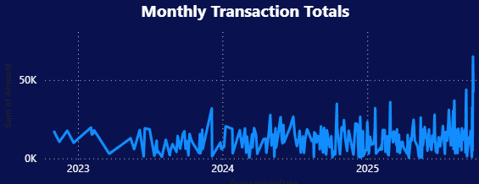
SQL Queries + Power Bi Charts Cont.
Monthly Transaction totals
QUERY: SELECT DATE_FORMAT(TransactionDate,'%Y-%M’)AS Month, SUM(Amount) AS TotalAmount FROM transactions GROUP BY month ORDER BY Month;
Transactions by status(Success/Failed)
QUERY:
SELECT status, COUNT(*) AS count FROM Transactions GROUP BY Status;

Slide 9
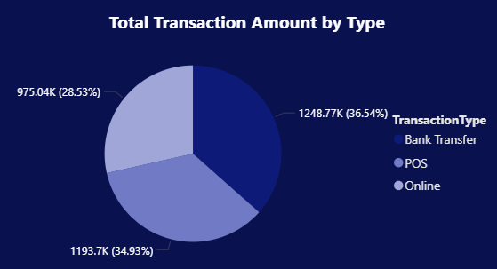
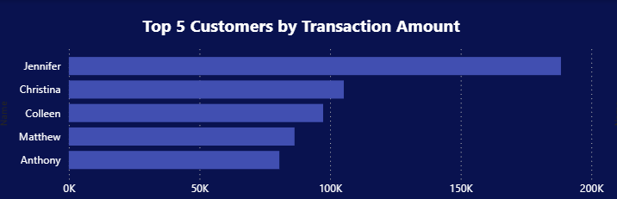
SQL Queries + Power Bi Charts Cont.
Top 5 customers by transaction amount
QUERY: SELECT c.name, SUM(t.Amount) AS TotalSpent FROM customers c JOIN Transactions t ON c.customerID = t.CustomerID GROUP BY c.name ORDER BY TotalSpent DESC LIMIT 5;
Total Transactions amount by type
QUERY: SELECT TransactionType, SUM(Amount) AS TotalAmount FROM Transactions GROUP BY TransactionType;

Slide 10
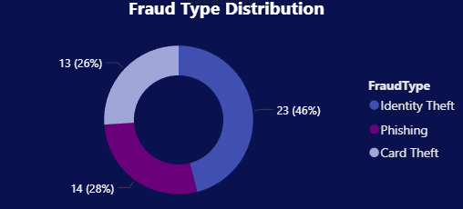
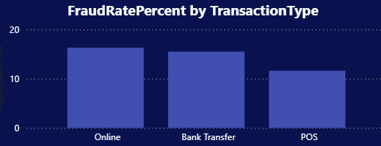
SQL Queries + Power Bi Charts Cont.
Fraud rate by transaction type
QUERY: SELECT t.TransactionType, (SUM(CASE WHEN f.IsFraud = 1 THEN 1 ELSE 0 END) * 100.0) / COUNT(t.TransactionID) AS FraudRatePercent FROM Transactions t LEFT JOIN FraudFlags f ON t.TransactionID = f.TransactionID GROUP BY t.TransactionType;
Fraud Type distribution
QUERY: SELECT FraudType, COUNT(*) AS Count FROM FraudFlags GROUP BY FraudType;

Slide 11
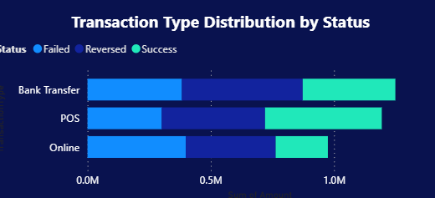
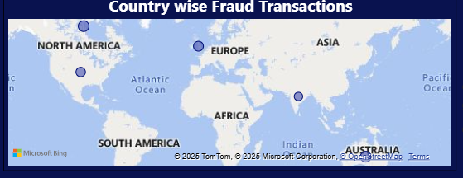
SQL Queries + Power Bi Charts Cont.
Country-wise fraud transactions
QUERY: SELECT c.country, COUNT(f.TransactionID) AS FraudCount FROM customers c JOIN Transactions t ON c.customerID = t.customerID JOIN FraudFlags f ON t.transactionID = f.TransactionID WHERE f.IsFraud = 1 GROUP BY c.country;
Transaction type distribution by status
QUERY: SELECT TransactionType, Status, COUNT(*) AS Count FROM Transactions GROUP BY TransactionType, Status;

Slide 12
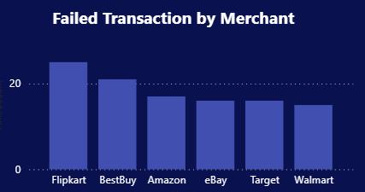
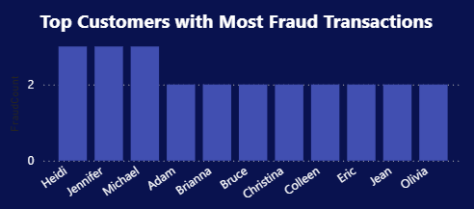
SQL Queries + Power Bi Charts Cont.
Top Customers with most fraud transactions
QUERY: SELECT c.Name, COUNT(f.transactionID) AS FraudCount FROM customers c JOIN Transactions t ON c.customerID = t.customerID JOIN FraudFlags f ON t.TransactionID = f.TransactionID WHERE f.IsFraud = 1 GROUP BY c.Name ORDER BY FraudCount DESC LIMIT 10;
Failed Transactions by merchant
QUERY: SELECT Merchant, COUNT(*) AS FailedCount FROM Transactions WHERE status = 'Failed’ GROUP BY Merchant;

Slide 13
INSIGHTS & FINDINGS
Fraud rate highest in Phishing transactions
Few merchants repeatedly targeted
High-value customers more prone to fraud attempts
Average detection delay ~3–5 days
Country-wise analysis shows regional risk hotspots

Slide 14
CONCLUSION & FUTURE SCOPE
SQL helped in data cleaning, querying & fraud detection
Power BI provided interactive dashboards
Future Scope:
Apply ML models for fraud prediction
Real-time fraud monitoring with alerts
Larger datasets for deeper insights

Slide 15

✨ Thank You ✨
Vannamathi B vannamathibaskaran@gmail.com

